Slide 1
Wexford County Council Agent Information Day
Disability Access Certificates (DAC’s)

Slide 2
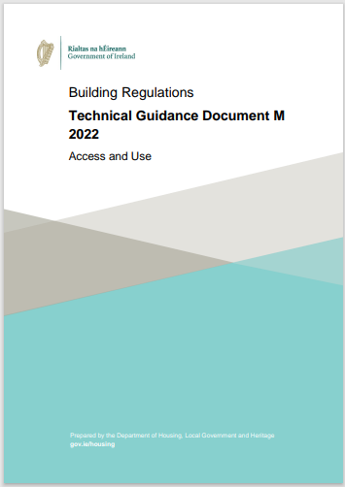
What is a Disability Access Certificate?
A Disability Access Certificate (DAC) is a certificate granted by a Building Control Authority which certifies compliance of the design of certain works if constructed in accordance with the granted Certificate, will comply with the requirements of Part M of the Building Regulations.
A DAC covers accessibility for a wide range of disabilities and not just for wheelchair users.
Compliance with Technical Guidance Document Part M demonstrates prima facia compliance with the Building Regulations.

Slide 3
Key Issues at Validation stage
No levels on drawings
Incorrect fee amount indicated at application
Incorrect floor area outlined in application

Slide 4
Key Issues at Assessment stage
Inconsistencies between the submitted drawings and Report
The report stating compliance with a specific section in the guidance while the drawings display a clear non-compliance
No outline of specific site constrains in the submitted report
Confirmation of the requirement of a changing places toilet as outlined in Table 1

Slide 5
Key Issues at Assessment stage
Inconsistencies between the submitted drawings and Report
The report stating compliance with a specific section in the guidance while the drawings display a clear non-compliance
No outline of specific site constrains in the submitted report
Confirmation of the requirement of a changing places toilet as outlined in Table 1
What are we looking for?
If there is a non-compliance state the nature and reason, so the assessor can make a determination
Outline items that may not be possible to comply with Part M due to the nature of the building
A general N/A is not sufficient it needs to be proven if a changing place toilet is or isn’t required

Slide 6
Key Issues at Assessment stage
Revised DAC’s
Incorrect floor areas given for Q7 on the application form
No clear outline/description of changes made between the Revised DAC and the Original DAC
Confirmation of the requirement of a changing places toilet as outlined in Table 1
No original layout has been submitted

Slide 7
Key Issues at Assessment stage
Revised DAC’s
Incorrect floor areas given for Q7 on the application form
No clear outline/description of changes made between the revised DAC and the original DAC
Confirmation of the requirement of a changing places toilet as outlined in Table 1
No original layout has been submitted
What are we looking for?
Accurate floor areas to be submitted
More detail of the description of works being carried out as part of the revised DAC
A general N/A is not sufficient it needs to be proven if a changing place toilet is or isn’t required
Submit original DAC drawings to display proposed changes

Slide 8
Application form Notes
Submitted Project Name | Revised Project Name
Residential Development Wexford | Slaney Drive Block A Carricklawn Wexford
Submitted Description | Revised Description
Extension to the rear of public house. | Proposed extension to public house. To consist of 45 additional seats, new accessible sanitary facilities and new bar to the rear of the extension. Access to the extension will be via the existing front bar an also via the eastern entrance accessible from the carpark.

Slide 9
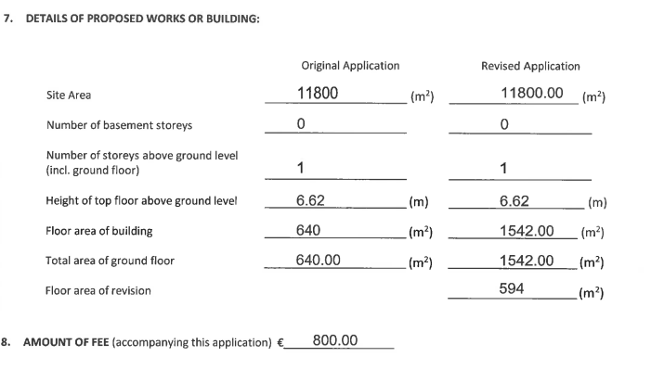
Example – Extension to School

Slide 10
Example – Extension to School
As per Table 1 a Changing Place Toilet is Required
Revised floor area clearly identified

Slide 11
Key Issues at Assessment stage
Setting Down Areas
A designated parking space being doubled up as a setting down area
No set down area provided in the application
Setting down area not in an appropriate location
What does the Guidance Say?
Section 1.1.6: Where there is a road on site leading to the building, there should be a setting down area provided at, or adjacent to, at least one accessible entrance. This facilitates a person arriving at a building as a passenger in a vehicle, to alight from the vehicle and enter the building safely and conveniently

Slide 12
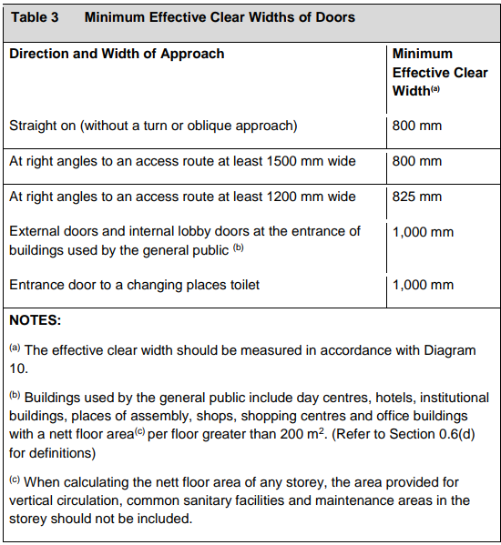
Key Issues at Assessment stage
Access to Buildings
Incorrect entrance door clear width
Door opening method not specified
Lobbies inadequately sized or incorrect clear opening of doors

Slide 13
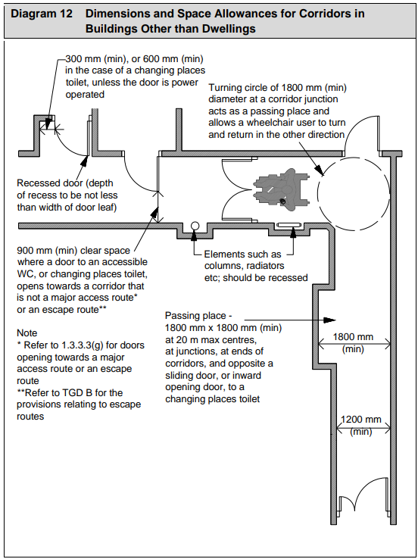
Key Issues at Assessment stage
Internal Circulation
Insufficient passing place/turning places in line with Section 1.3.3.3
Corridor width less than 1200mm
Doors opening out into corridors/passageways, note for major access routes (Section 1.3.3.3 (g))
No provision for a lift or inadequately sized

Slide 14
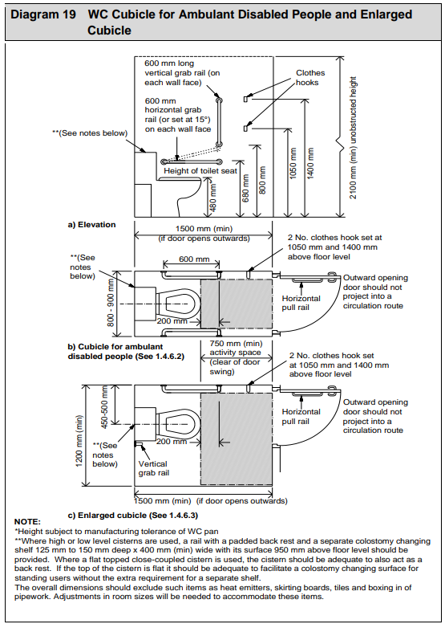
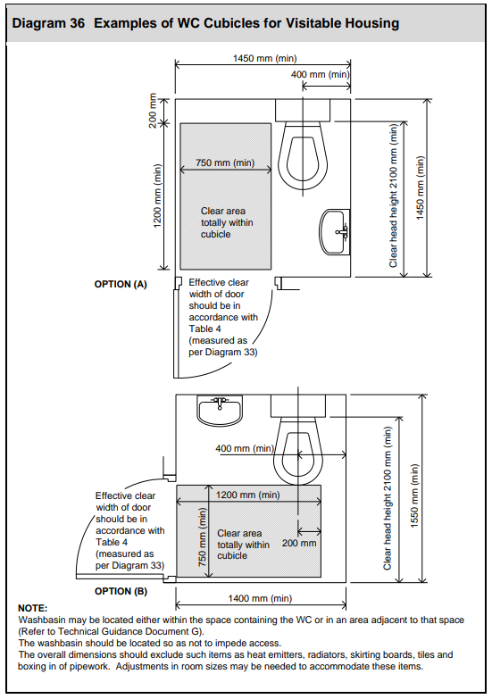
Key Issues at Assessment stage
Sanitary Facilities
Incorrect provision of cubicles in line with Section 1.4.3.2
Incorrect Wheelchair Accessible Unisex WX provided in line with Section 1.4.3.1 (a)
Transfer zone for a visitable WC in a dwelling doesn’t fit as per Diagram 36

