Slide 1
Wexford County Council Agent Information Day
Construction Product Regulations 2023
Notes:
1

Slide 2
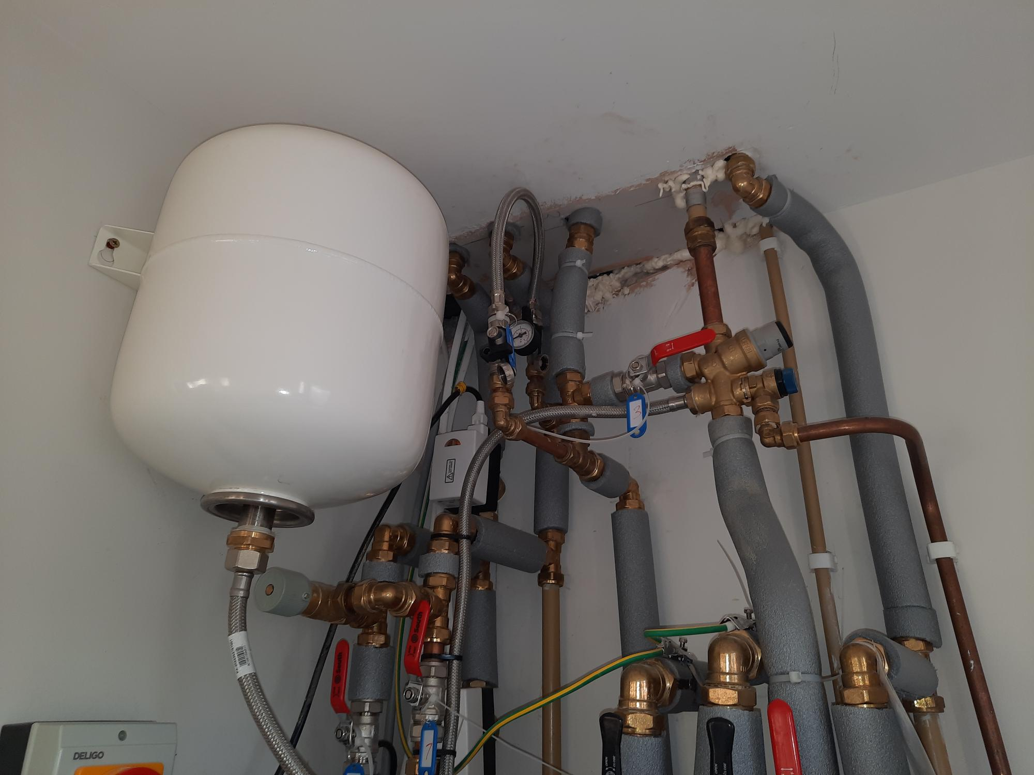
Firestopping

Slide 3


Slide 4
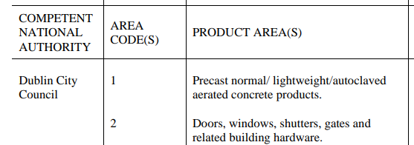


What’s new in CPR 2023
On-line sales
New Competent National Authority – NBCMSO
Proactive Market Surveillance

Slide 5



Original CPR 2013
Competent National Authorities

Slide 6

Origin of CPR – 1989 - EEC
EU Regulations 305/2011 (CPR) & 1020/2019 (MSR)
Manufacturers Affix CE mark
Declarations of Performance

Slide 7
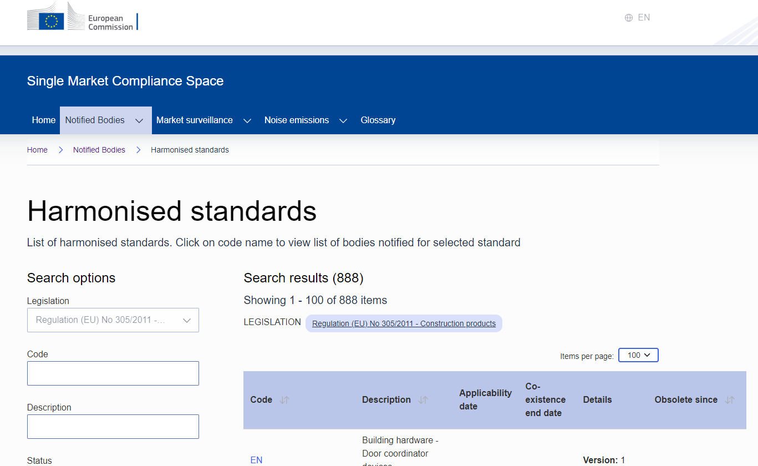
Harmonised European Standards
888 hENs
MANDATORY

Slide 8
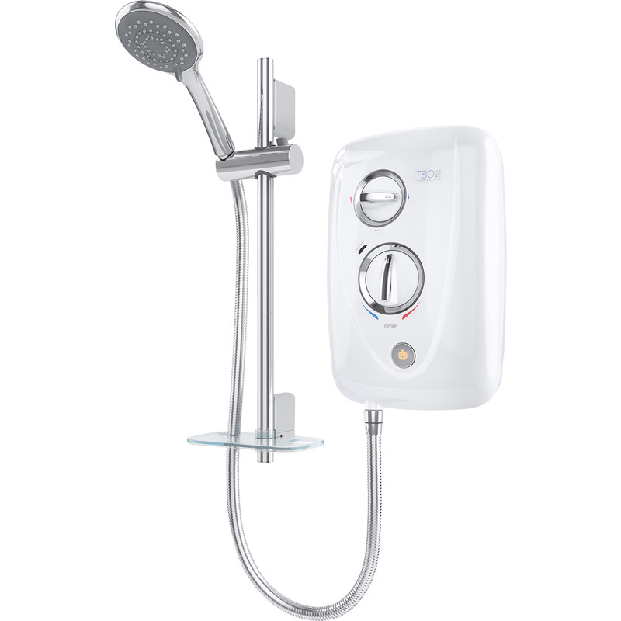
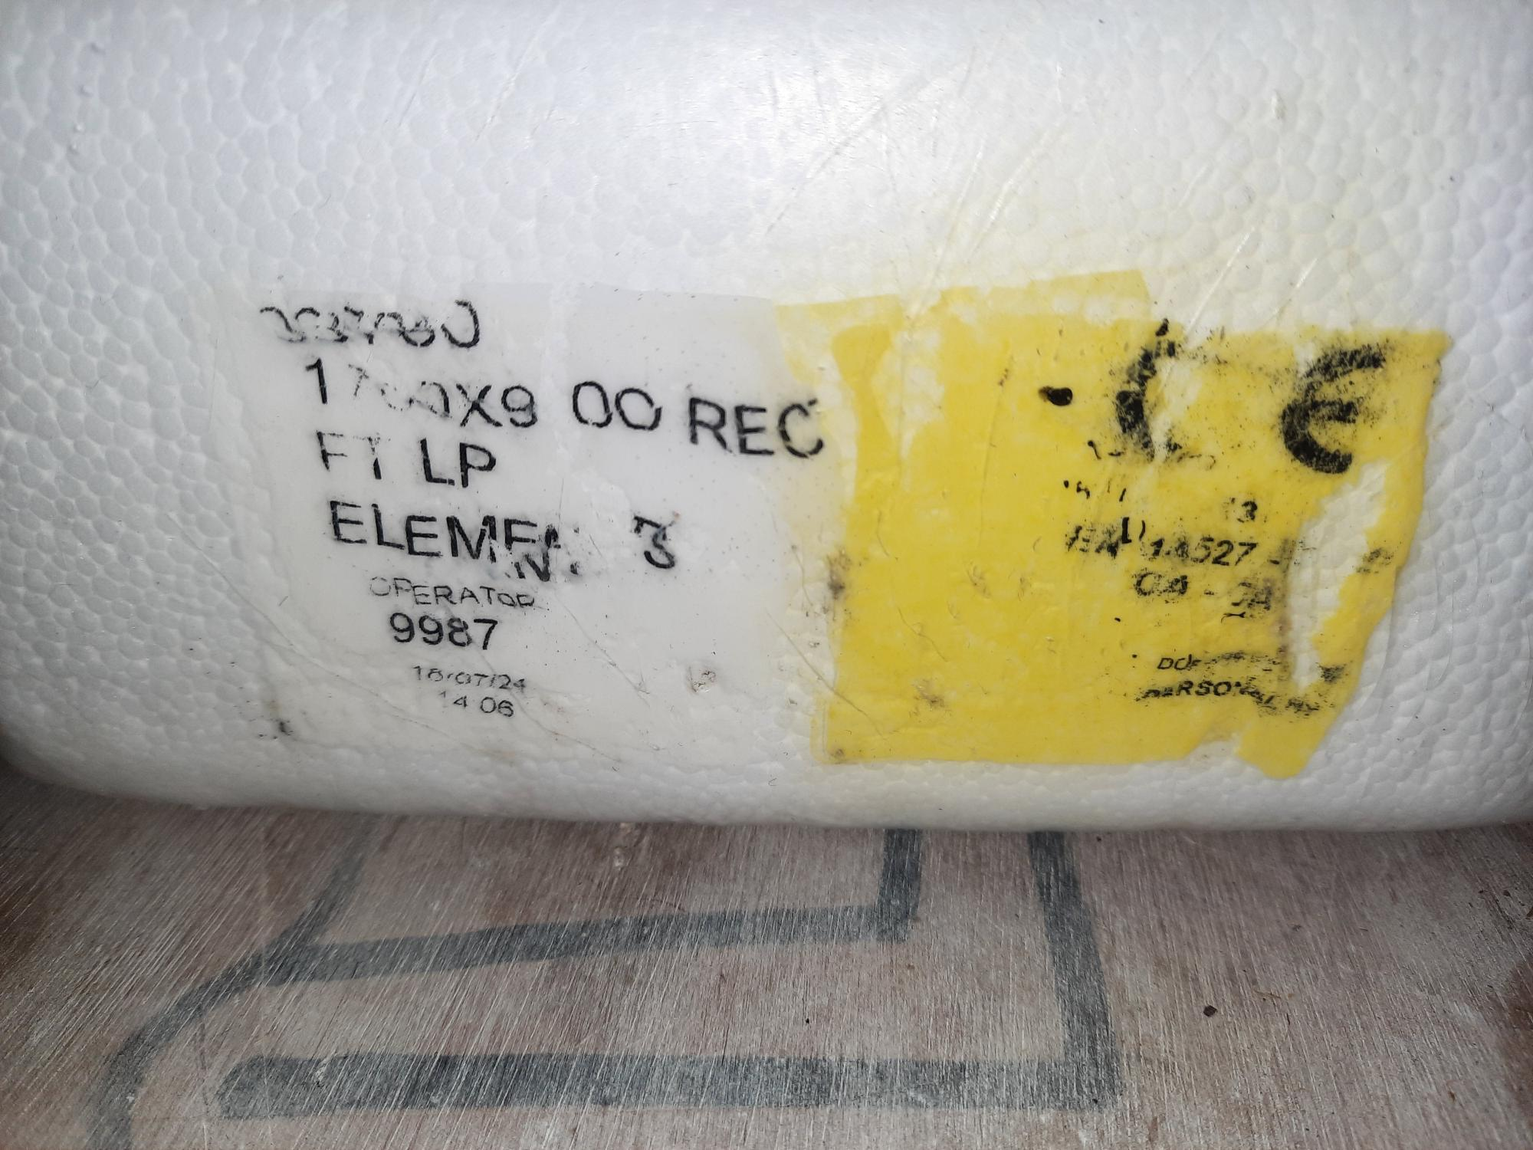
Searching Harmonised Standards
Low Voltage Directive EU 2014/35
  Cabinet
Construction Product Regulations – EU305/2011
  Trays
  Enclosures

Slide 9

Concrete Blocks
EN 771-3 DoP
EN 12620 Aggregates for Concrete & SR16
NSAI Cert for FPC
Instructions/Health & Safety
Traceability

Slide 10
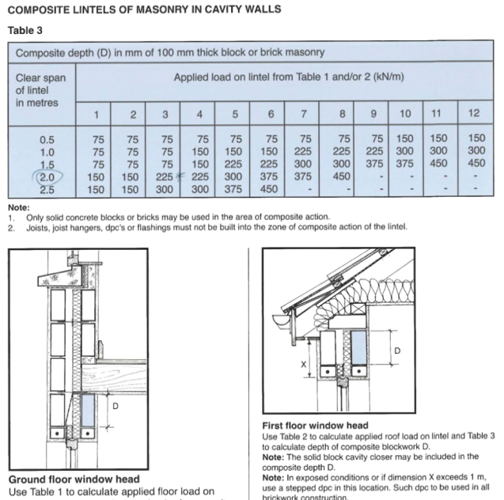
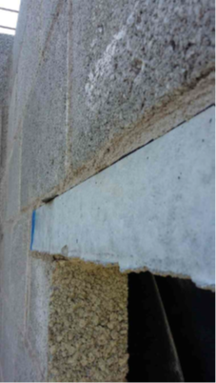
Lintels…
Manufacturer’s Instructions……

Slide 11
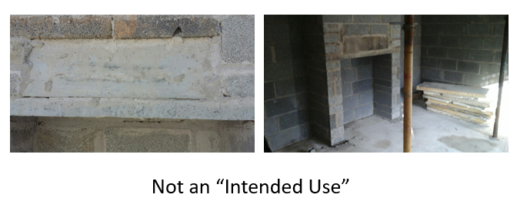
Lintels…
Intended Use……

Slide 12

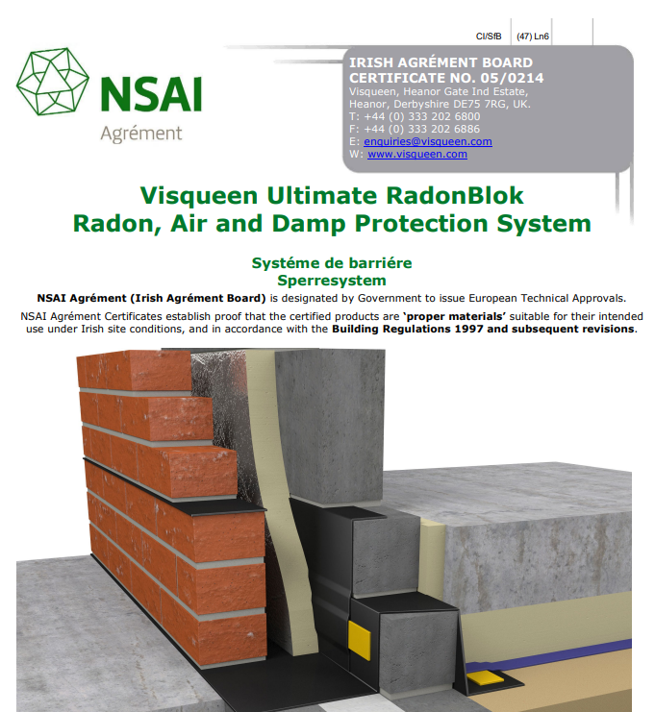
Damp Proof Membranes & Radon Barriers
DPMs - CE Marking
Radon Barriers - IBA Certs

Slide 13

Market Surveillance
Authorised Officers
Inspections take Samples
Notices & Corrective Actions
Product Recalls by Ministerial Order
Offences & Penalties

Slide 14


Brexit
UK Notified Bodies are no longer EU Notified Bodies
UK Manufacturers need an EU-27 ‘notified body’ - BRE now in Ireland
Validity of British Board of Agrement Certificates (BBA Certs)

Slide 15
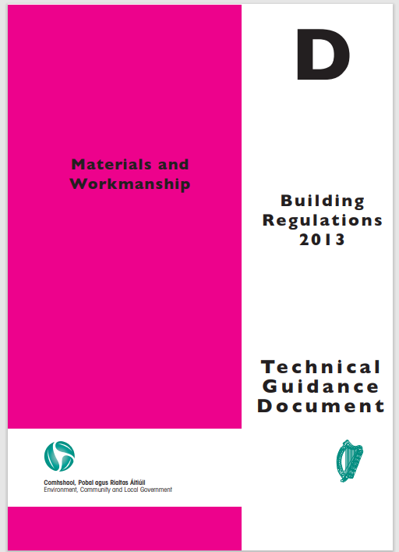

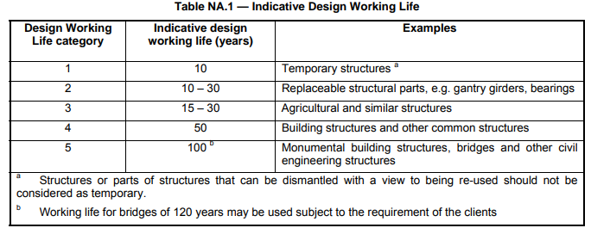
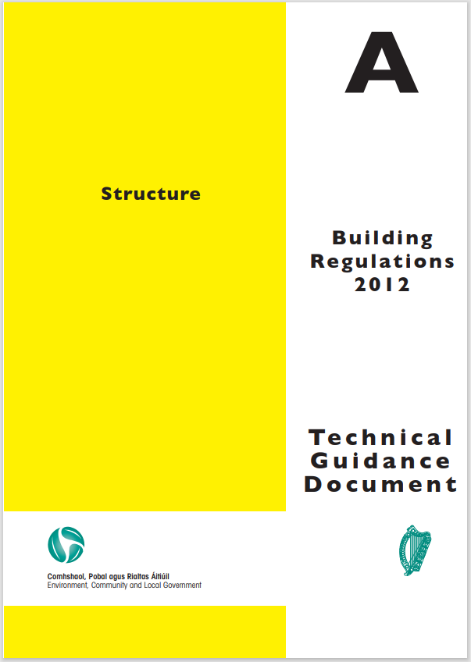

Irish Building Regulations
CE Marked, ETA (National Annexes) or IBA through NSAI
Performance in Use
Design Life

Slide 16

Modern Methods of Construction
NSAI Certification
    Insulated Concrete Formwork (ICF)
    Light Guage Steel Structures (LGSS)
    Timber Frame and Metal Web Joists

Slide 17
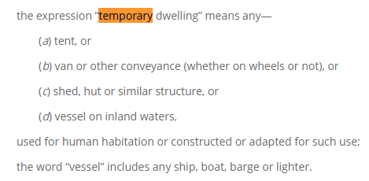

Log Cabins
LOCAL GOVERNMENT (SANITARY SERVICES) ACT, 1948.

Slide 18
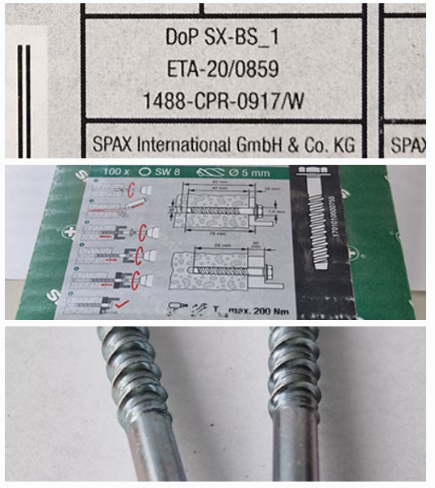
ICSMS & RAPEX
ICSMS
  Information and Communication System for Market Surveillance
RAPEX
  Rapid Alert

Slide 19
Thank You

