Slide 1
Aims & Objectives
BCMS / TGD-B Vol 1: 2024
Darren Buchanan
Senior Assistant Chief Fire Officer
27/11/24

Slide 2
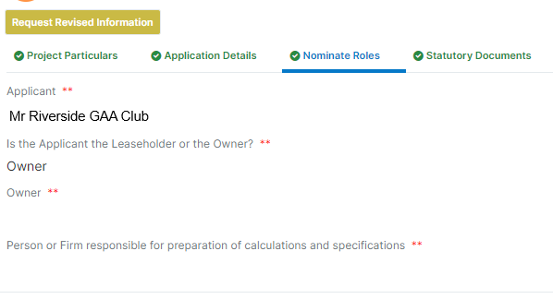
Aims & Objectives
BCMS – Validation
Nominated Roles

Slide 3
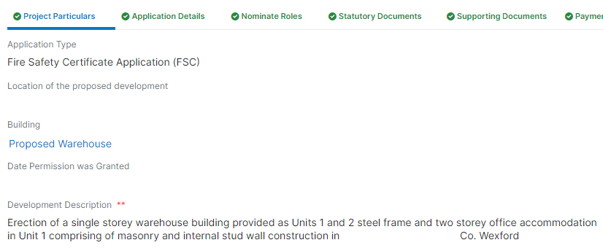
Aims & Objectives
BCMS – Validation
2. Development Description

Slide 4
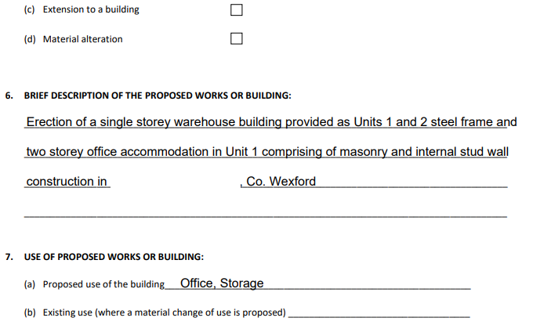
Aims & Objectives
BCMS – Validation
2. Development Description

Slide 5
Aims & Objectives
Technical Guidance Document B Vol 1: 2024
Objectives:
Changes to the Building Regulations
Implementation/Transitional Arrangements
Highlight the main changes

Slide 6
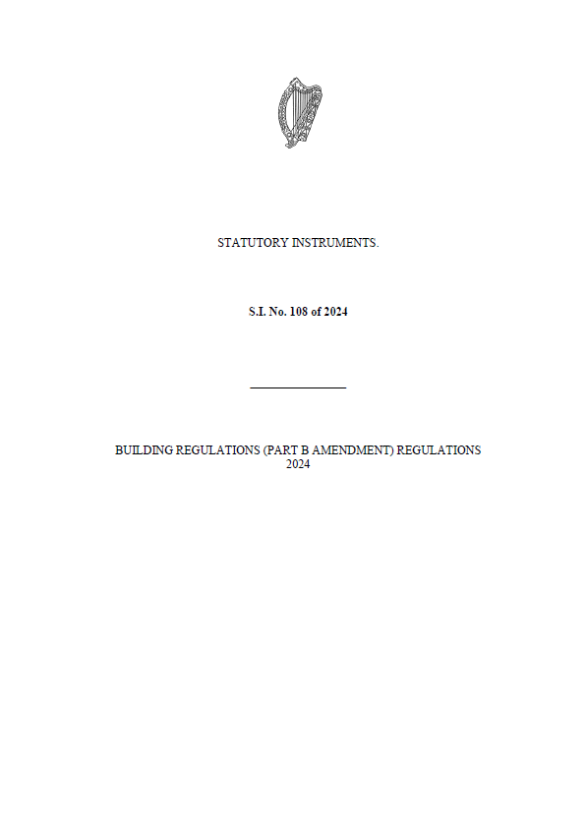
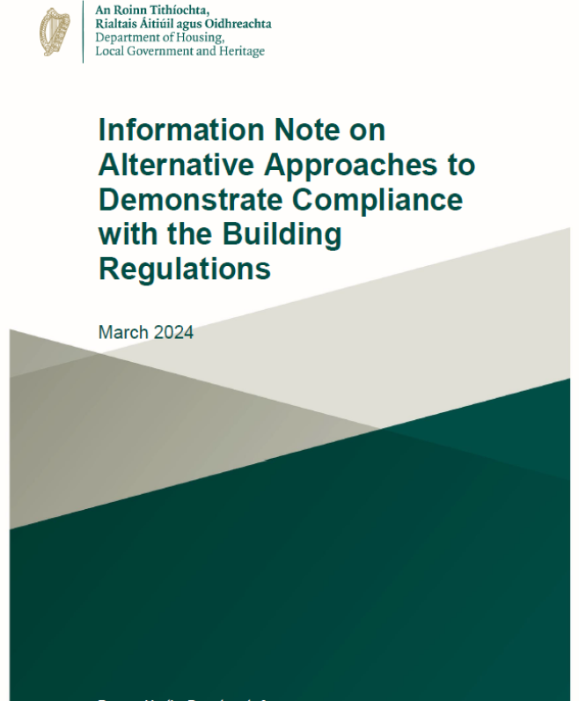
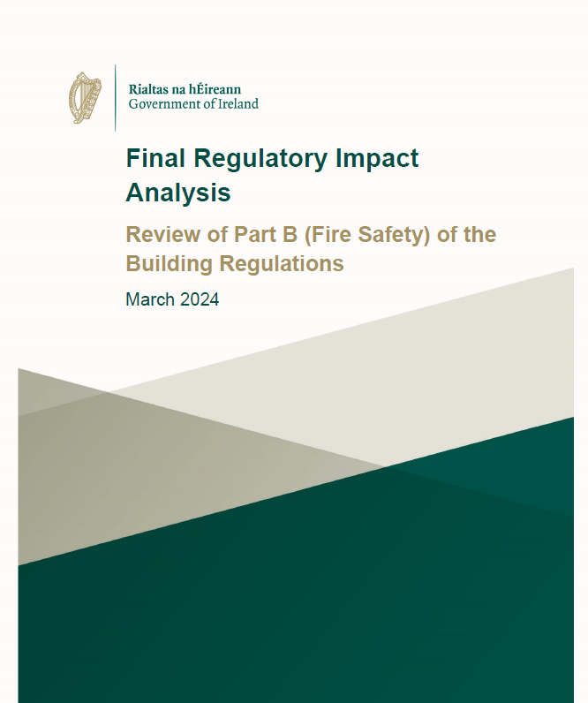
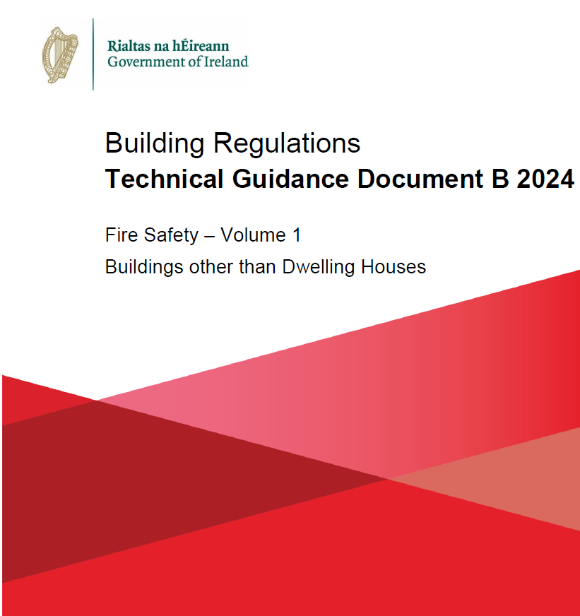
Aims & Objectives
Technical Guidance Document B Vol 1: 2024

Slide 7
Aims & Objectives
Technical Guidance Document B Vol 1: 2024
Building Regulations:
S.I. No. 108 of 2024: Published 26 March 2024
Comes into effect 01 May 2025

Slide 8
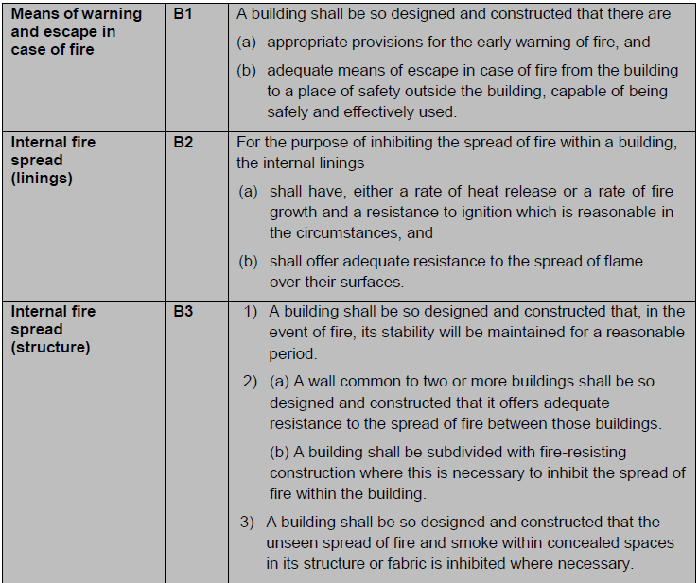
Aims & Objectives
Technical Guidance Document B Vol 1: 2024

Slide 9
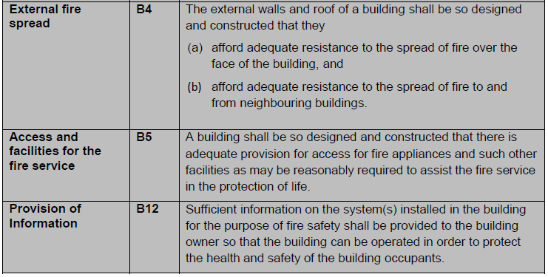
Aims & Objectives
Technical Guidance Document B Vol 1: 2024

Slide 10
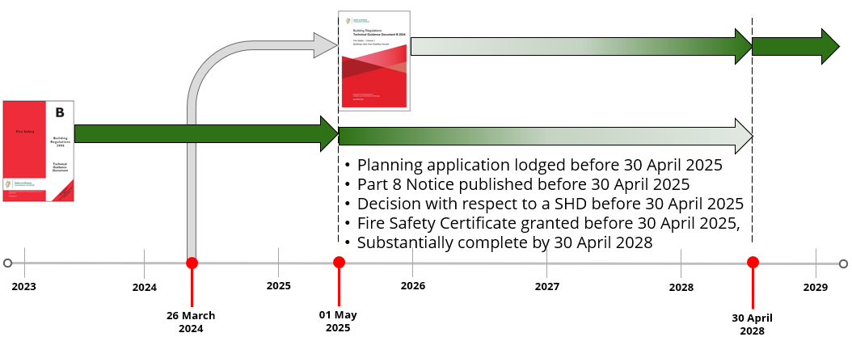
Aims & Objectives
Technical Guidance Document B Vol 1: 2024
Implementation:

Slide 11
Aims & Objectives
Technical Guidance Document B Vol 1: 2024
Transitional Arrangements:
Planning application lodged before 30 April 2025
Part 8 Notice published before 30 April 2025
Decision with respect to a Strategic Housing Development before 30 April 2025
Fire Safety Certificate granted before 30 April 2025
And Substantially complete by 30 April 2028

Slide 12
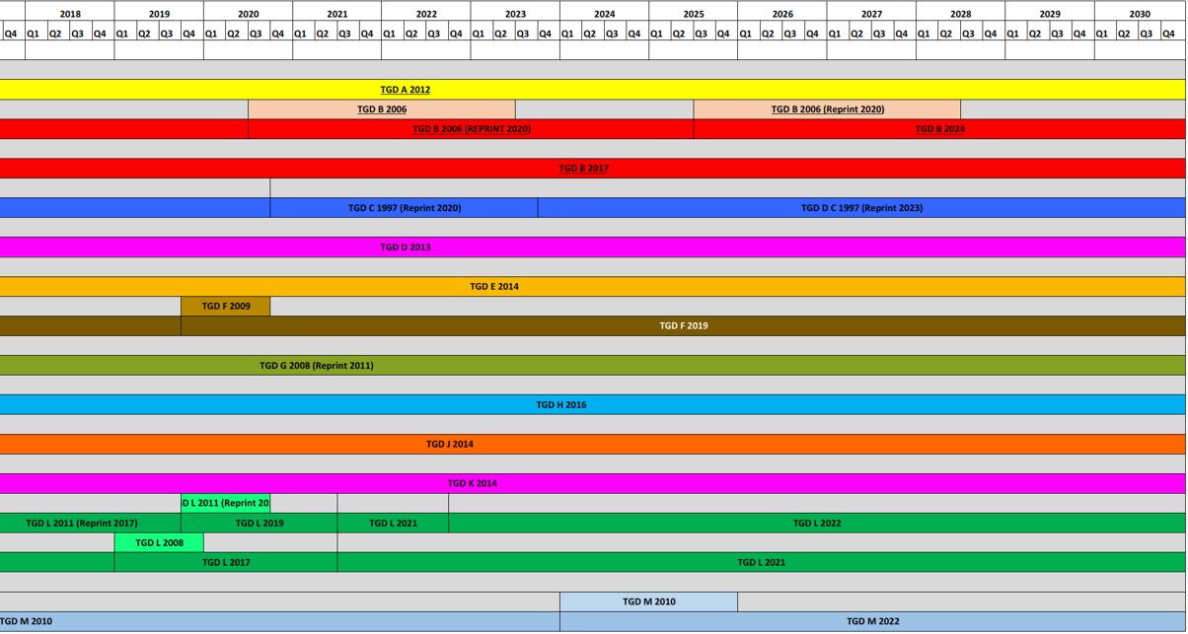
Aims & Objectives

Slide 13
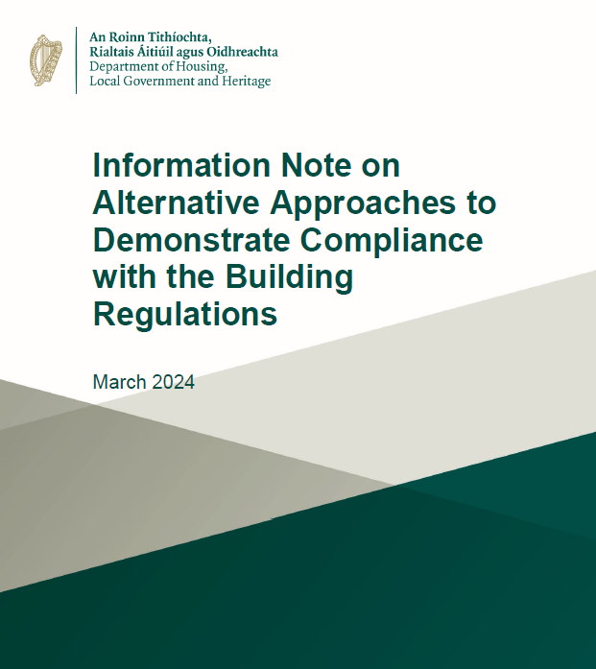
Aims & Objectives
Technical Guidance Document B Vol 1: 2024
Page 2: Alternative Approaches
Article 7(3) of S.I. No. 497 of 1997
Parts A-M
Primary responsibility for compliance with the requirements of the Building Regulations rests with the designers, builders and owners of buildings.
Impact on other Requirements
Appendix G:
BS 9991, BS 9999, CIBSE Guide E,
BS 7974:2019

Slide 14
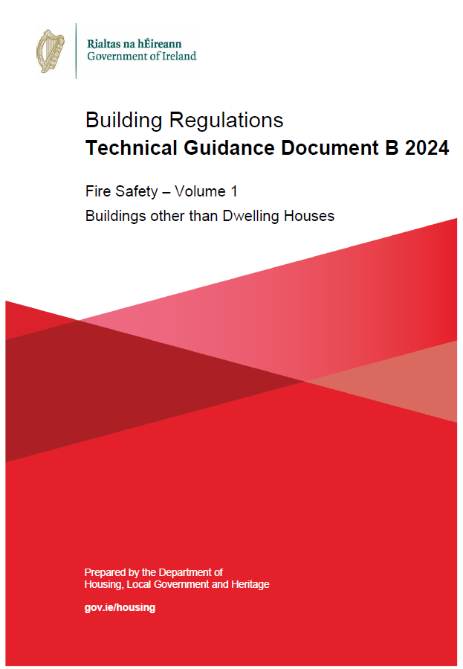
Aims & Objectives
Technical Guidance Document B Vol 1: 2024
Section 1: Means of Warning and Escape in Case of Fire
Section 2: Internal Fire Spread (Linings)
Section 3: Internal Fire Spread (Structure)
Section 4: External Fire Spread
Section 5: Access and Facilities for the Fire Service
Section 6: Smoke Control
Section 7: Existing Buildings
Section 8: Sprinklers

Slide 15
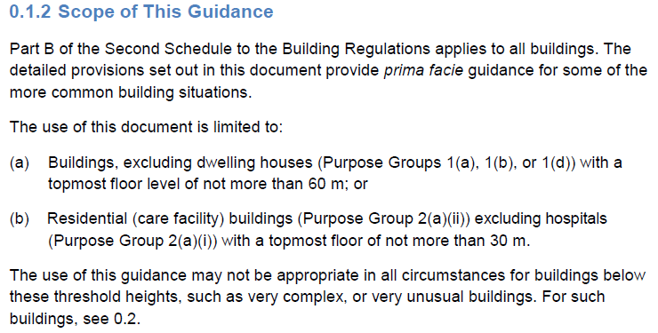
Aims & Objectives
Technical Guidance Document B Vol 1: 2024
Section 1: Means of Warning and Escape in Case of Fire

Slide 16
Aims & Objectives
Technical Guidance Document B Vol 1: 2024
Section 1: Means of Warning and Escape in Case of Fire
Inclusion of :
Flats / Maisonettes – BS 5588 Part 1
Offices – BS 5588 Part 11
Shops & Shopping Centres – BS 5588 Part 11 & 10
Assembly & Recreation Buildings including Schools – BS 5588 Part 6 & BB100

Slide 17
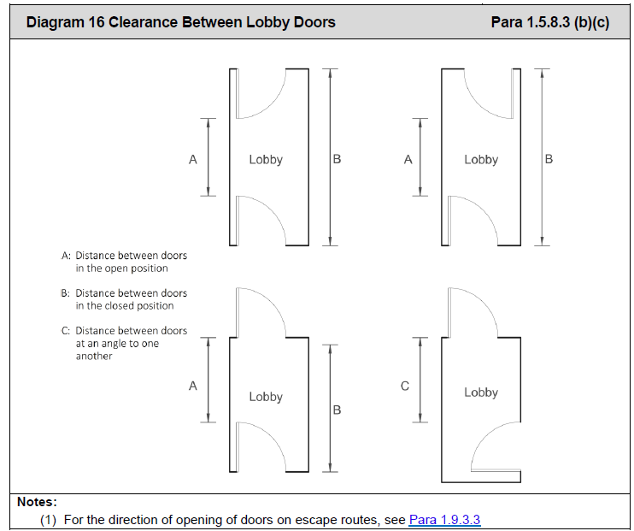
Aims & Objectives
Technical Guidance Document B Vol 1: 2024
Section 1: Means of Warning and Escape in Case of Fire
Aligning with other Building Regulations
Part M: Lobbies – Minimum distance between
doors 1.57m, A or C
Previously – 0.5m
Minimum Clear Door Widths – 800mm

Slide 18
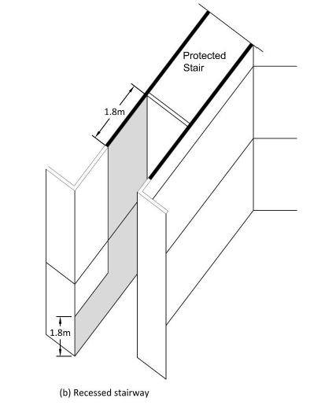
Aims & Objectives
Technical Guidance Document B Vol 1: 2024
Section 1: Means of Warning and Escape in Case of Fire
Aligning with other Building Regulations
Updated Diagrams and more information
Move away from British Standards

Slide 19
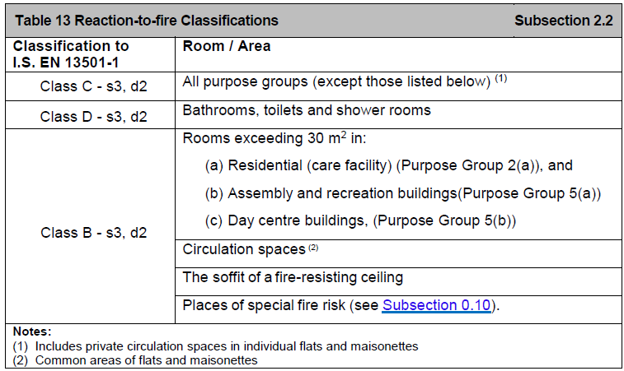
Aims & Objectives
Technical Guidance Document B Vol 1: 2024
Section 2: Internal Fire Spread (Linings)
European Classifications to
I.S. EN 13501-1

Slide 20
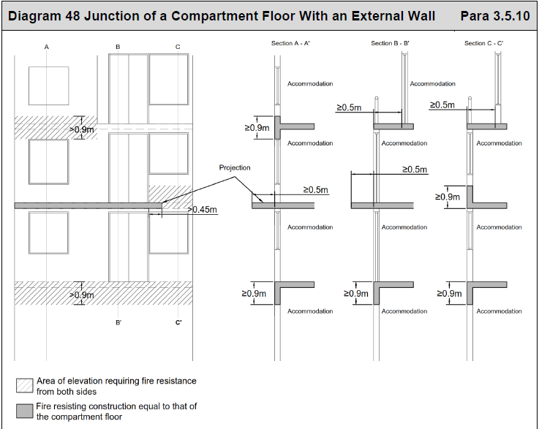
Aims & Objectives
Technical Guidance Document B Vol 1: 2024
Section 3: Internal Fire Spread
(Structure)
Building with topmost floor over 15m:
Compartment Floor meets an External Wall
Sprinkler System
0.9m fire-resisting zone
Projection 0.5m
Recess of 0.5m

Slide 21
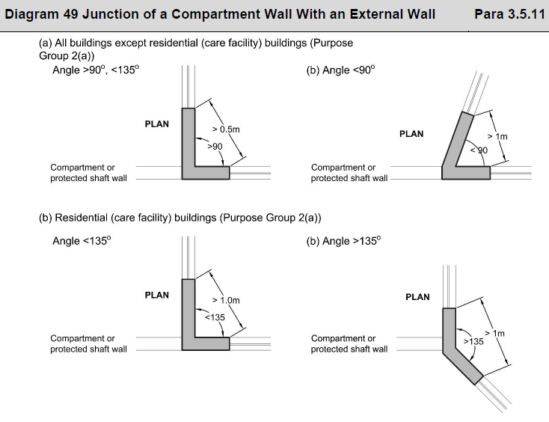
Aims & Objectives
Technical Guidance Document B Vol 1: 2024
Section 3: Internal Fire Spread
(Structure)
Compartment Wall meets an External Wall
No requirement if sprinklered

Slide 22
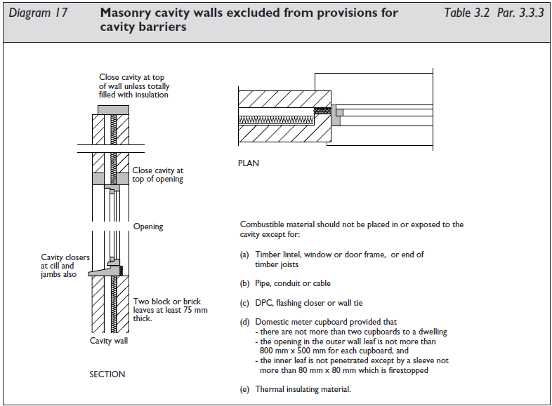
Aims & Objectives
Technical Guidance Document B Vol 1: 2024
Section 3: Internal Fire Spread
(Structure)
Cavity Barriers

Slide 23
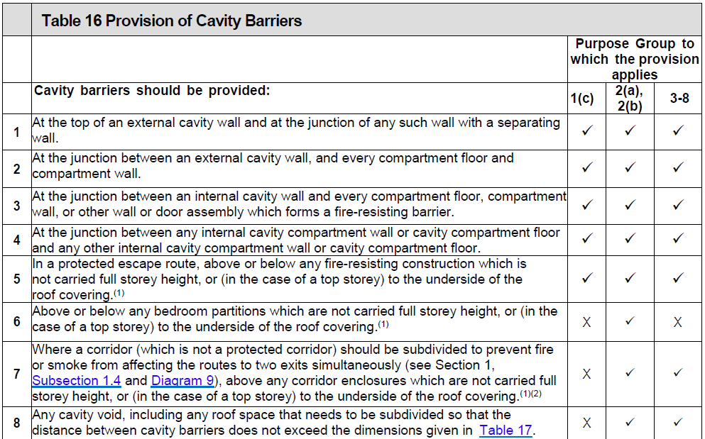
Aims & Objectives
Technical Guidance Document B Vol 1: 2024
Section 3: Internal Fire Spread
(Structure)
Cavity Barriers
Table 16
Ventilation Systems
Building containing an Atrium

Slide 24
Aims & Objectives
Technical Guidance Document B Vol 1: 2024
Section 4: External Fire Spread

Slide 25
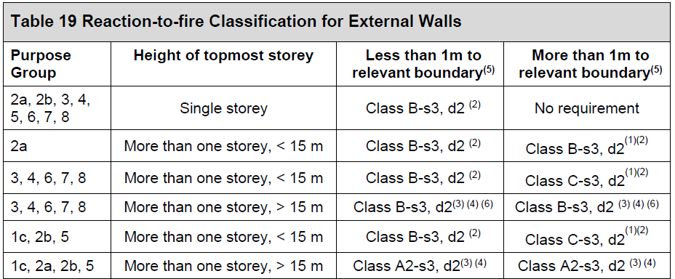
Aims & Objectives
Technical Guidance Document B Vol 1: 2024
Section 4: External Fire Spread
Fire Spread on
External Walls
Do not achieve the
Rating = full scale test
to BS 8414

Slide 26
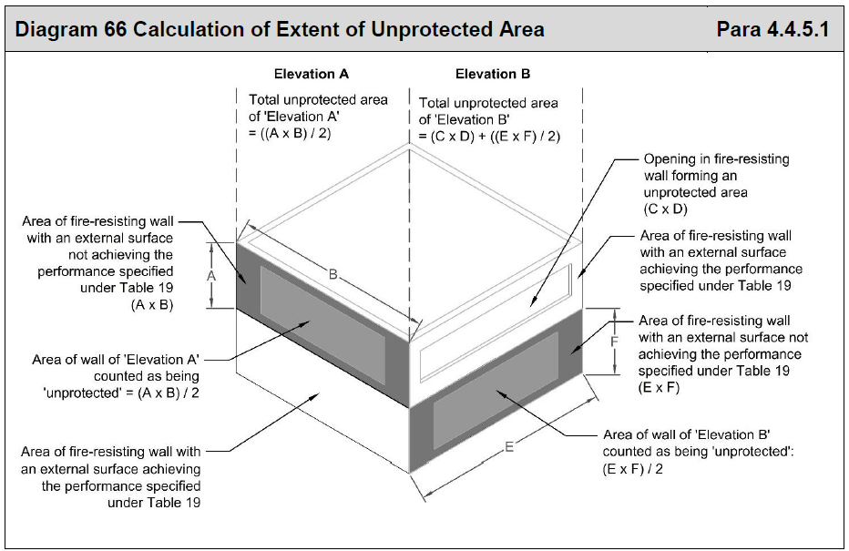
Aims & Objectives
Technical Guidance Document B Vol 1: 2024
Section 4: External Fire Spread
Unprotected Areas and Fire Resistance
Where an external surface does not achieve a reaction to fire classification of Class A – s3, d2, half of that part of the wall should be classified as unprotected

Slide 27
Aims & Objectives
Technical Guidance Document B Vol 1: 2024
Section 5: Access and Facilities for the Fire Service

Slide 28
Aims & Objectives
Technical Guidance Document B Vol 1: 2024
Section 5: Access and Facilities for the Fire Service
Internal Fire Mains
One protected shaft [Stair] with a fire main <900m²
45m hose distance from the stair door

Slide 29
Aims & Objectives
Technical Guidance Document B Vol 1: 2024
Section 5: Access and Facilities for the Fire Service
Design of Firefighting Shafts
Walls
Lobbies
Stairs
Lift
Fire mains
Power supplies

Slide 30
Aims & Objectives
Technical Guidance Document B Vol 1: 2024
Section 6: Smoke Control
Escape Stairs
Firefighting Shafts
Atria
Basements
Common Corridors – Apartments
Large undivided/Windowless Spaces – Industrial/Storage
Theatres
Shopping Centres

Slide 31
Aims & Objectives
Technical Guidance Document B Vol 1: 2024
Section 6: Smoke Control
Escape Stairs
Vent must be automatic – either Roof or Wall Mounted
Large Undivided Spaces….
No cubic capacity given, 4000m²

Slide 32
Aims & Objectives
Technical Guidance Document B Vol 1: 2024
Section 7: Existing Buildings | Section 7.0.1
Where works or a material change of use is carried out on an existing building, the provisions of Sections 1 to 6 should be achieved, where possible.
However, in existing buildings, there may be constraints that would not exist in new buildings. In the case of existing buildings, therefore, some variations of the provisions set out in Sections 1 to 6 of this document may be appropriate. These are set out in this section (Section 7).
Where some of the provisions of Sections 1 to 7 cannot be reasonably achieved, compensating measures (see Para 7.0.2) may be considered. However, the principles of fire safety should be the same as those set out in Sections 1 to 6.

Slide 33
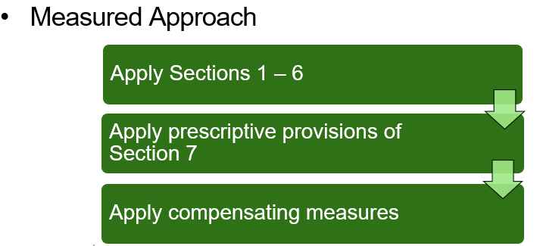
Aims & Objectives
Technical Guidance Document B Vol 1: 2024
Section 7: Existing Buildings | Section 7.0.1

Slide 34
Aims & Objectives
Technical Guidance Document B Vol 1: 2024
Section 7: Existing Buildings
Building existed Pre 1992 [32 years]: Material Alterations which require a FSCA
Use the Guides published by the NDFEM
Building Post 1992: Comply with the relevant TGD B at the time
Any new elements must comply with Section 1 – 6. Any existing element to comply with the above and Section 7.

Slide 35
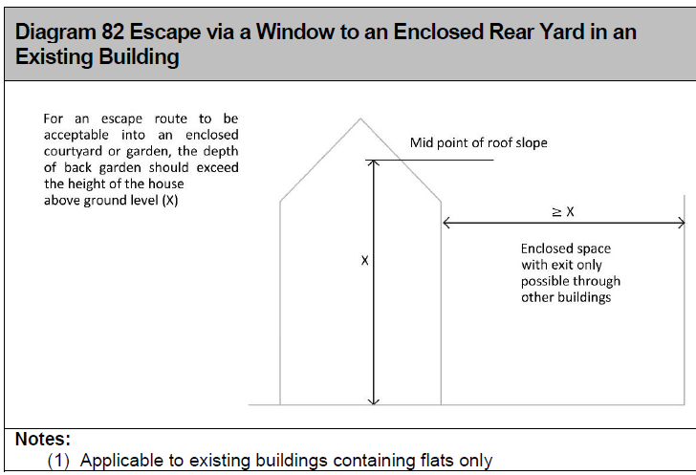
Aims & Objectives
Technical Guidance Document B Vol 1: 2024
Section 7: Existing Buildings | B1
FD20 Doorsets
750mm door widths
Single stair office building – no lobbies
Escape from a flat to an enclosed yard
External Stair – unlimited height
Existing Stair – construction
Provisions for small premises extended
Café re-heating food only

Slide 36
Aims & Objectives
Technical Guidance Document B Vol 1: 2024
Section 8: Sprinklers
Flats >15m
Student Accommodation >15m
Residential Care Facility Buildings – bed spaces above ground level
Extensions:
a) existing building sprinklered
b) extension over 400m² or exceeds ¼ of the floor area of the existing building and bed spaces above ground level
Shopping Centres
Other buildings over 30m
Not on the list PG 2(b) Hotel, Hostel etc

Slide 37
Aims & Objectives
Technical Guidance Document B Vol 1: 2024
Section 8: Sprinklers
Residential Sprinkler systems – Flats, Residential Care Facility Buildings, Student Accommodation
All other purpose groups – I.S. EN 12845

Slide 38
Aims & Objectives
Technical Guidance Document B Vol 1: 2024
Appendix B – Fire Doors

Slide 39
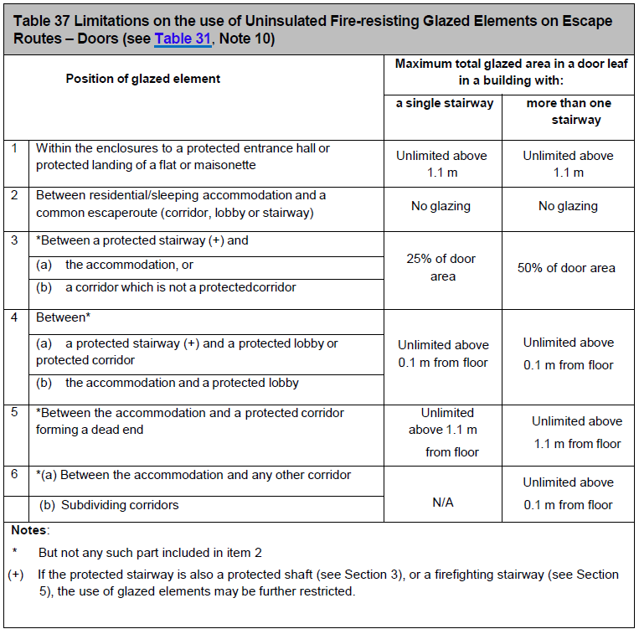
Aims & Objectives
Technical Guidance Document B Vol 1: 2024
Appendix B – Fire Doors

Slide 40
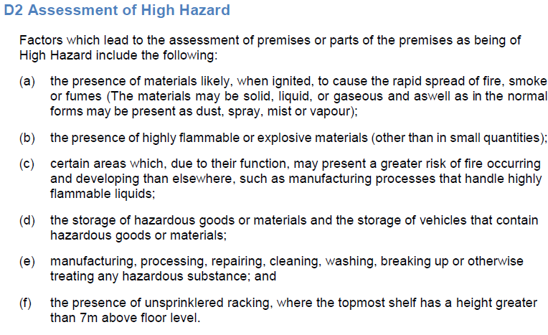
Aims & Objectives
Technical Guidance Document B Vol 1: 2024
Appendix D: Assessment of Fire Hazard and Associated Life Risk

Slide 41
Aims & Objectives
Technical Guidance Document B Vol 1: 2024
Building Regulation 12:

Slide 42
Aims & Objectives
Technical Guidance Document B Vol 1: 2024
Thanks for your Attention

